Slide 1
Distributed Control and Automation Framework (DCAF)
Creating a DCAF Application
Instructor Name
Instructor’s role
Notes:
People that contributed with this content:
Benjamin Celis
Mathew Pollock
Simon Perez
Andres Gomez

Slide 2
Agenda
Exercise Introduction
Outline and Checklist
Creating Main VI Using Execution Templates
Exercise
Using DCAF Configuration Editor
Loading Dependencies and the Module Includes VI
Deploying Configuration File
Running Main VI
Exercise
Quiz

Slide 3
Exercise Introduction

Slide 4
Exercise Project without Hardware
Engine 2 (Controller)
Engine 1 (Host)
Temperature Controller
>>PID Settings
>>Setpoint
>>Fan On?
>>Temperature
Fan Control>>
Lamp Control>>
UI
PID Settings>>
Setpoint>>
Fan On?>>
Temperature<<
Lamp<<
UDP
>>PID Settings>>
>>Setpoint>>
>>Fan On?>>
<<Temperature<<
<<Lamp<<
UDP
>>PID Settings>>
>>Setpoint>>
>>Fan On?>>
<<Temperature<<
<<Lamp<<
Temperature Chamber Model
>>Fan Control
>>Lamp Control
<<Temperature<<

Slide 5
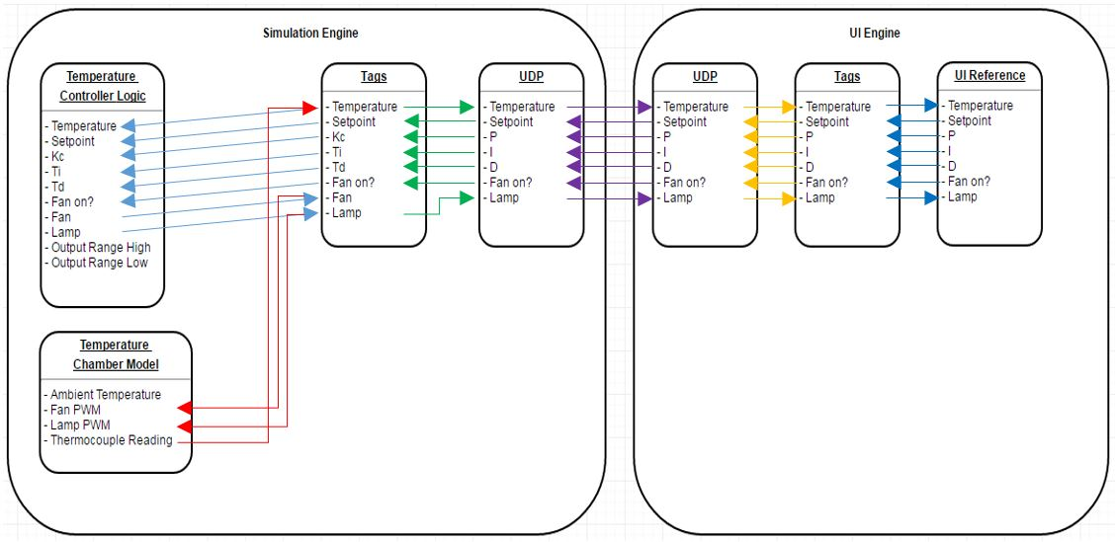
Exercise Project without Hardware
2 Engines
UDP for E3E
Temperature control
Acquire Data Scan Engine
PID Control
Log To Disk
UI

Slide 6
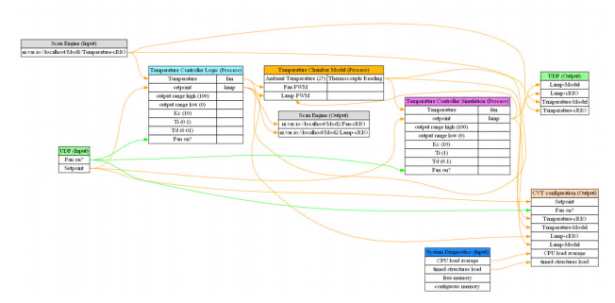
Exercise Project With Hardware
2 Engines
UDP for E3E
Temperature control
Acquire Data Scan Engine
PID Control
Log To Disk
UI
Notes:
Provide UI

Slide 7
Outline and Checklist

Slide 8
Outline and Checklist
Create a Main VI for each execution target (windows, cRIO, etc.) using DCAF's execution templates.
Download existing DCAF module plugins and design, build, and test new modules if needed.
Configure system behavior using the DCAF Standard Configuration Editor.
Include dependencies.
Deploy an up-to-date config file to each execution target at the appropriate location.
Run the application from the development environment and troubleshoot as needed.
Build the application into an executable and troubleshoot as needed once again.

Slide 9
Creating Main VI Using Execution Templates

Slide 10
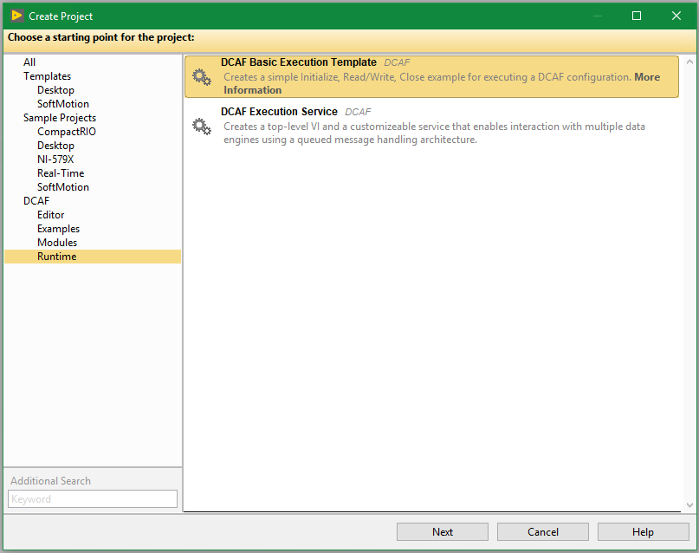
Runtime Templates

Slide 11
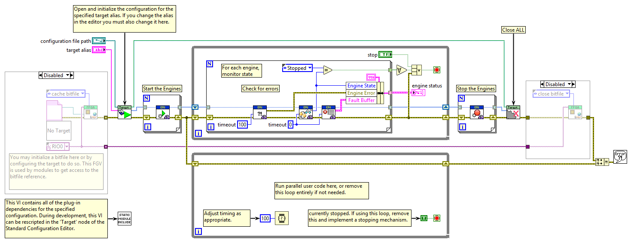
Basic Execution Template

Slide 12
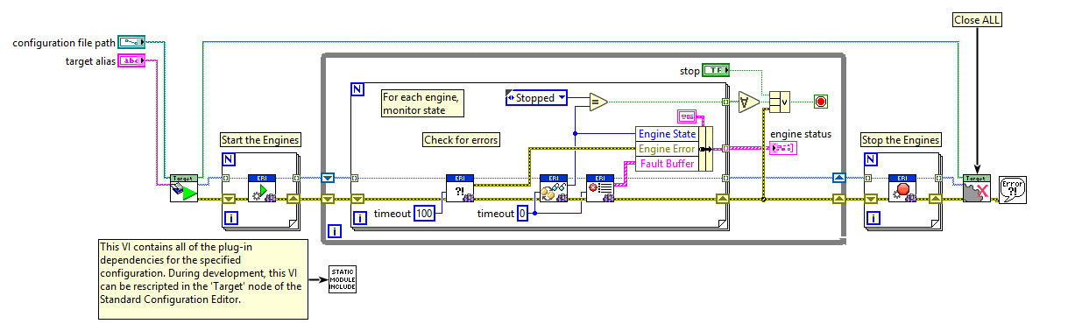
Most Common Case of the template

Slide 13
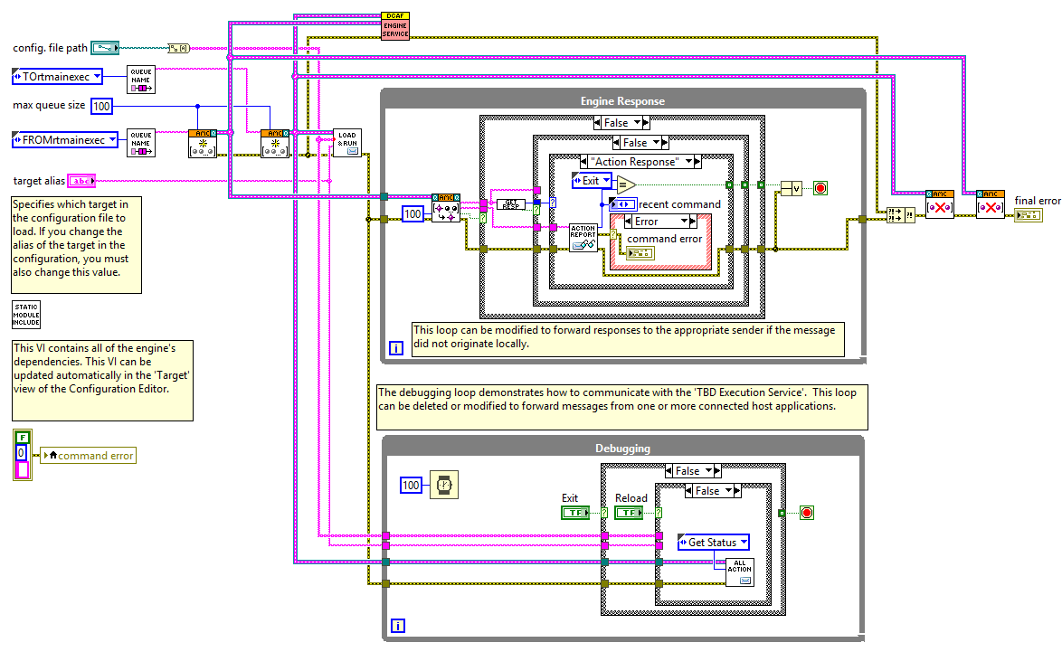
Services template

Slide 14
Exercise
Hands On 1 Exercise 1 Part A
Notes:
https://github.com/LabVIEW-DCAF/Documentation/blob/master/Trunk/Getting%20Started%20Material/Hands%20On/Hands-On_1/DCAF_Hands_On_1.md
Students will follow the instructions to finish Hands On 1: Part A: Project Creation and UI
Estimated Time: 12 minutes.

Slide 15
Using DCAF Configuration Editor

Slide 16
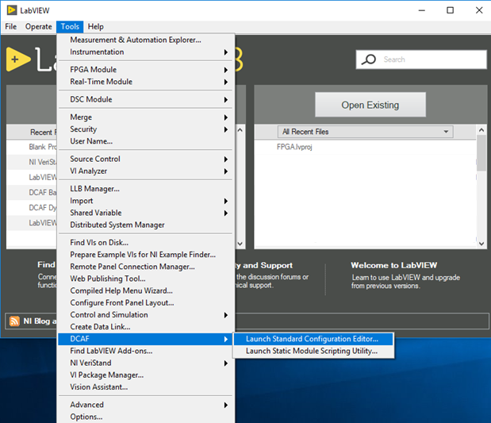
Launching Configuration Editor

Slide 17
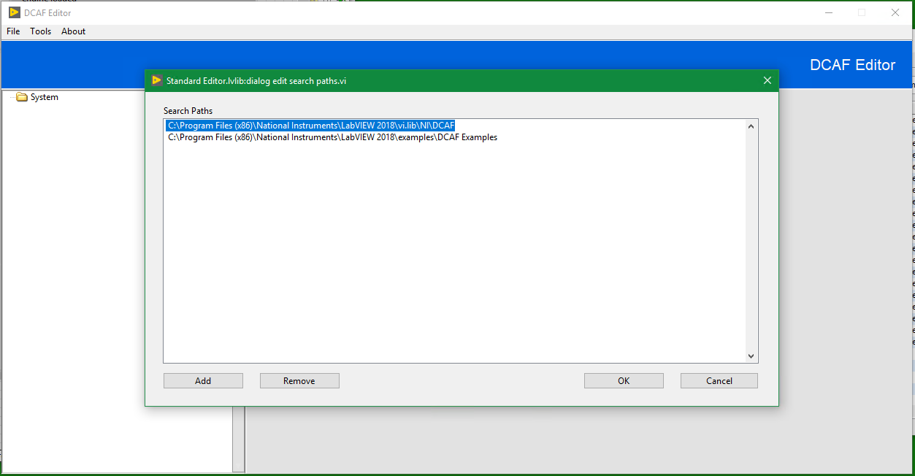
Search Paths
Notes:
Tools >> Edit Plugin Search Paths

Slide 18
Creating the System Hierarchy

Slide 19
Create and Map Tags

Slide 20
Configure Engine and Modules

Slide 21
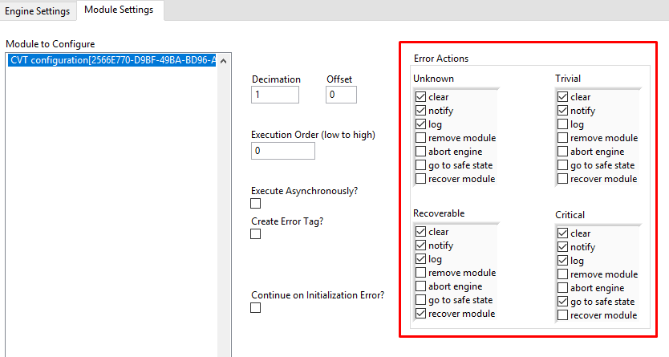
Error Handling
Notes:
Error actions are configurable per module.

Slide 22
Loading Dependencies and the Module Includes VI

Slide 23
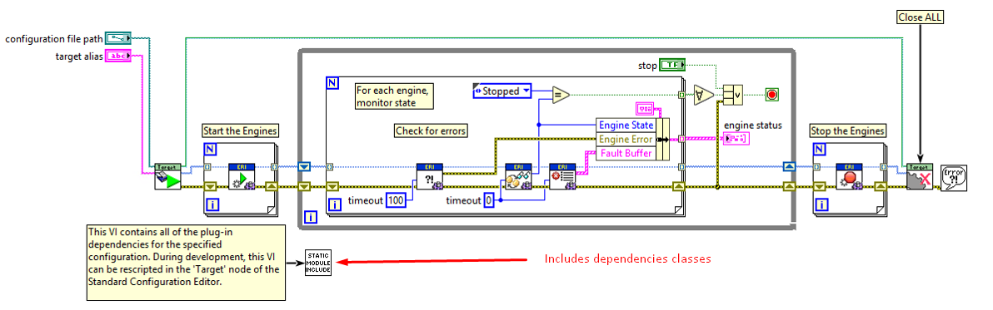
Loading Dependencies
DCAF is a plugin-based framework without static dependencies between the framework and its modules.
Dependencies must be loaded into memory before the DCAF configuration file is parsed.

Slide 24
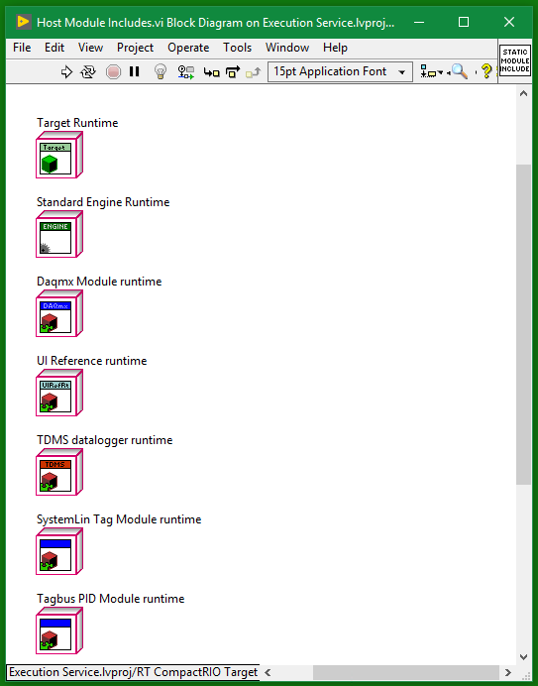
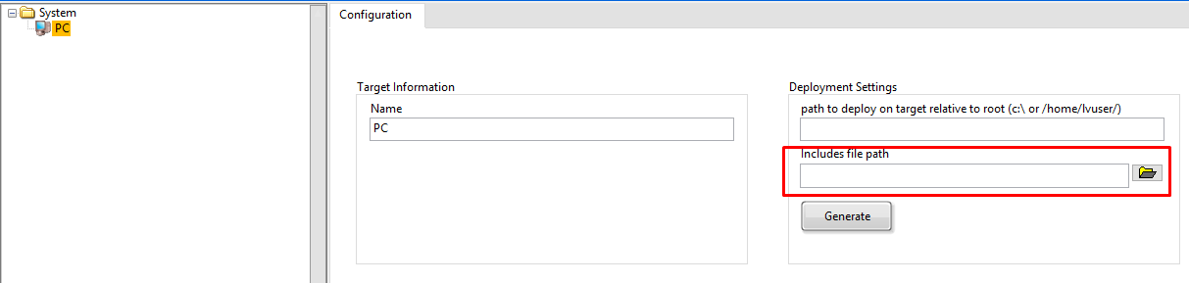
Script Includes
You should run this every time you add new modules to the configuration
It updates the includes VI

Slide 25
Deploying Configuration File

Slide 26
Deploying a Configuration File
Before running the code on a remote target, the .pcfg configuration file needs to be deployed.
Solutions:
Use DCAF built-in tool in the editor.
Manually transfer files (WebDAV, FTP, etc).
Have the application automatically pull file from remote location.

Slide 27
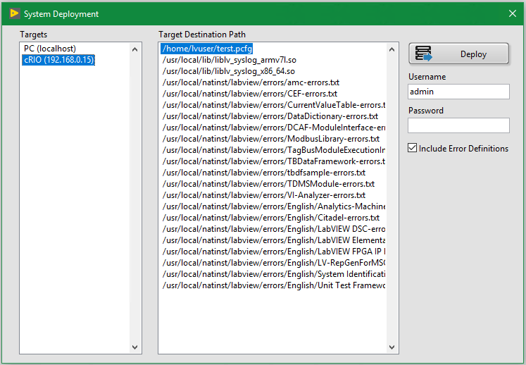
Deployment
Tools >> Deploy Tool from DCAF Editor.
SSH Enabled in Target.

Slide 28
Running Main VI

Slide 29
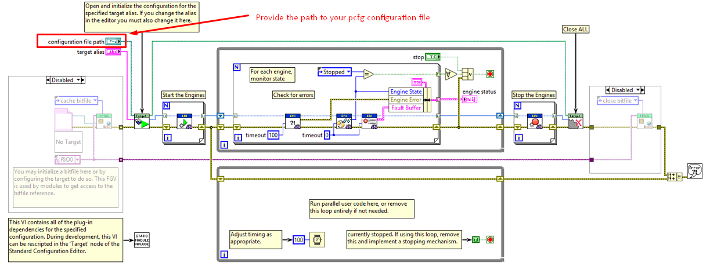
Running Main VI

Slide 30
Exercise
Hands On 1 Exercise 1 Parts B and C
Notes:
https://github.com/LabVIEW-DCAF/Documentation/blob/master/Trunk/Getting%20Started%20Material/Hands%20On/Hands-On_1/DCAF_Hands_On_1.md
Students will follow the instructions to finish:
Hands On 1: Part B: Adding Required Classes
Hands On 1: Part C: Mapping Tags in the Configuration Editor
Estimated Time: 30 minutes. Students that finish early can start working on the next exercise.

Slide 31
Exercise (optional)
Hands On 1 Exercise 2
Notes:
Optional exercise for those we finished early.
https://github.com/LabVIEW-DCAF/Documentation/blob/master/Trunk/Getting%20Started%20Material/Hands%20On/Hands-On_1/DCAF_Hands_On_1.md
Hands On 1: Exercise 2: Adding Standard Modules to the Temperature Control Application (TDMS & CVT)
Estimated Time: 15 minutes. Have students working on this exercise only if you are going ahead with the schedule.

Slide 32
Quiz

Slide 33
What Templates Exist to Launch my Runtime DCAF Application?
Static Module Template
DCAF Execution Service
DCAF Configuration Editor
DCAF Basic Execution Template
Notes:
B and C

Slide 34
What Templates Exist to Launch my Runtime DCAF Application?
Static Module Template
DCAF Execution Service
DCAF Configuration Editor
DCAF Basic Execution Template
Notes:
B and C

Slide 35
Select the option that represents the right order of containment in DCAF
>> means the element in the left contains the element in the right.
Target >> System >> Engine >> Module
Module >> System >> Target >> Engine
System >> Target >> Engine >> Module
System >> Engine >> Target >> Module
Notes:
C

Slide 36
Select the option that represents the right order of containment in DCAF
>> means the element in the left contains the element in the right.
Target >> System >> Engine >> Module
Module >> System >> Target >> Engine
System >> Target >> Engine >> Module
System >> Engine >> Target >> Module
Notes:
C

Slide 37
Which of the steps below do I need to execute after making changes to my DCAF Configuration File?
Re-script the Includes VI with the dependencies classes, only if new modules were added.
Re-create my LabVIEW project using one of the templates
Deploy the updated configuration file in case it is a remote target.
If I am running an executable, recompile it regardless of the changes that were made.
Notes:
A and C

Slide 38
Which of the steps below do I need to execute after making changes to my DCAF Configuration File?
Re-script the Includes VI with the dependencies classes, only if new modules were added.
Re-create my LabVIEW project using one of the templates
Deploy the updated configuration file in case it is a remote target.
If I am running an executable, recompile it regardless of the changes that were made.
Notes:
A and C

Slide 39
Outline and Checklist Review
Create a Main VI for each execution target (windows, cRIO, etc.) using DCAF's execution templates.
Download existing DCAF module plugins from the community and design, build, and test new modules if needed.
Configure system behavior using the DCAF Standard Configuration Editor.
Load the code for each dependent plugin module within the appropriate Main VI.
Deploy an up-to-date config file to each execution target at the appropriate location.
Run the application from the development environment and troubleshoot as needed.
Build the application into an executable and troubleshoot as needed once again.

Slide 40
Resources

Slide 41
Resources
DCAF Developer Guide:
Chapter 3: Creating a New Application
Notes:
https://github.com/LabVIEW-DCAF/Documentation/blob/master/Trunk/Getting%20Started%20Material/devguide/ch3_Creating%20a%20new%20Application.md

